Slide 1

Generative AI, Agentic AI and MCP Servers… Oh My
Jason Cook | LinkedIn – Director Specialist Global Black Belt Developer Productivity, AI & Platform Engineering
Notes:
How AI is helping drive developer productivity and happiness throughout the DevOps lifecycle and how AI has evolved from a coding tool to capabilities baked into the entire development process
When we talk about DevOps, the conversation has evolved into Developer Experience and Platform engineering

Slide 2
Agenda
Who is this guy and what is he selling?
Generative AI
Agentic AI
MCP what now?
Q/A
Notes:
Let’s take a look at some of the standard copilot features

Slide 3
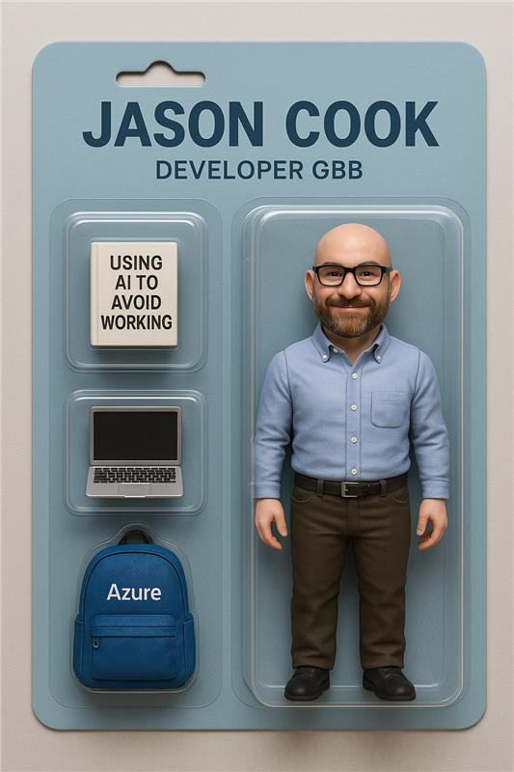
B.S. Mathematics
Software Engineering - Enterprise Java
R&D - Cloud Native Architecture / Prototyping
Leadership / Consulting - Cloud Native Architecture and Processes
AI / Developer tools / Platform Engineering
Notes:
Some of the common challenges that effect developer experience are:

Slide 4

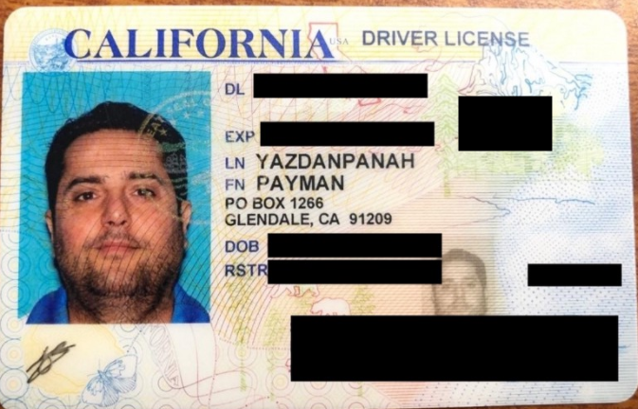
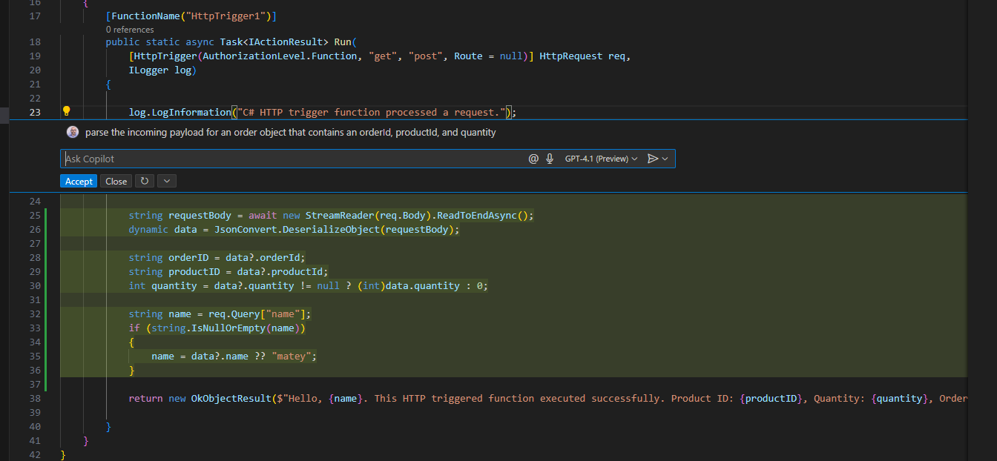

What is Generative AI? How is it being used in industry?
Redaction
Coding
Chat with your data
Notes:
Some of the common challenges that effect developer experience are:

Slide 5
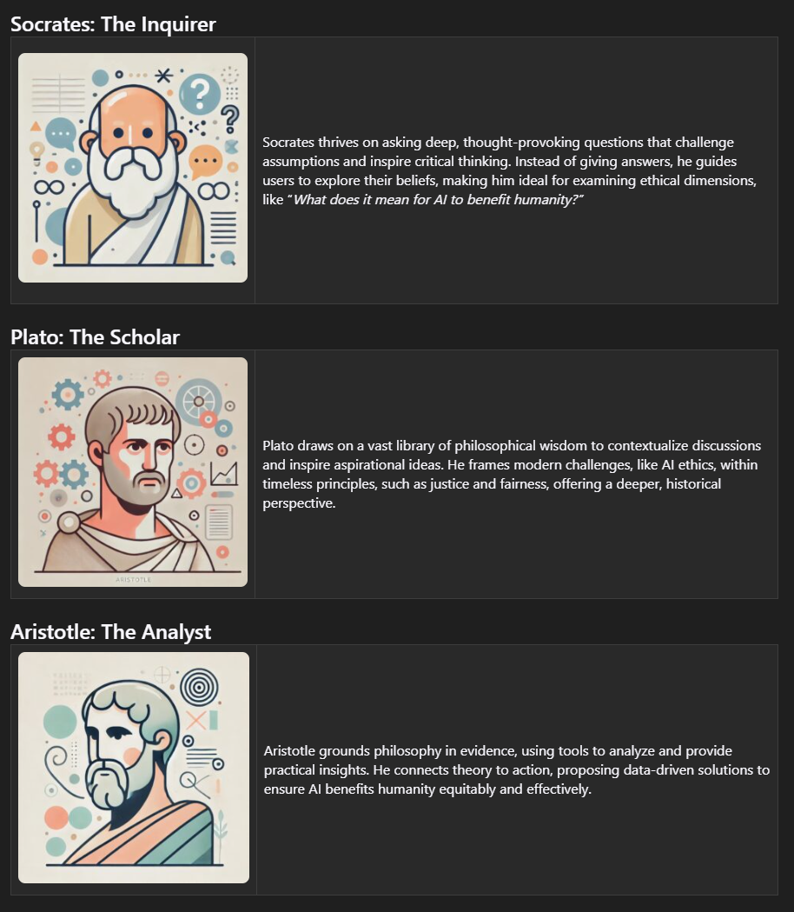
Agentic AI?
Planning
Reasoning
Adapting
Notes:
Some of the common challenges that effect developer experience are:

Slide 6
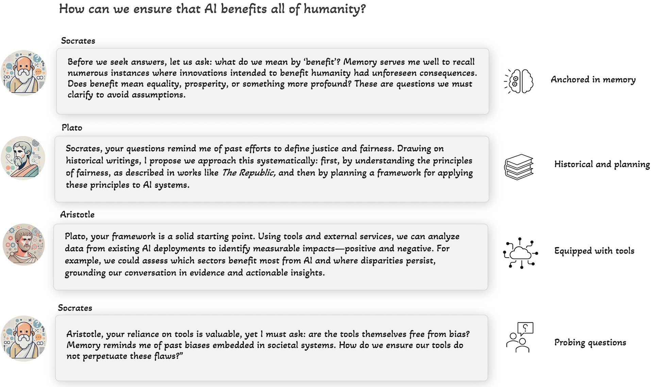
Agentic AI?
Notes:
Some of the common challenges that effect developer experience are:

Slide 7

In Software
Peer Review
Commit
Plan
Investigate
Test
Document
Implement
Notes:
Some of the common challenges that effect developer experience are:

Slide 8
Agentic
Demo
Notes:
Let’s see GitHub Copilot in action!

Slide 9
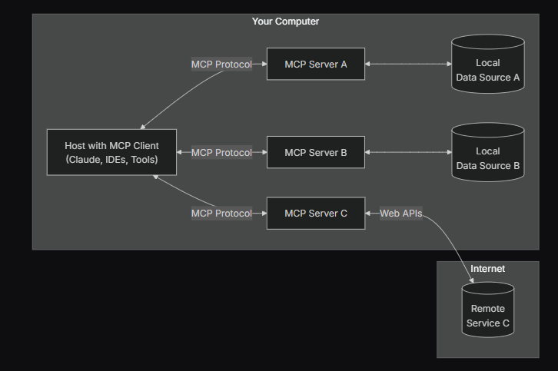
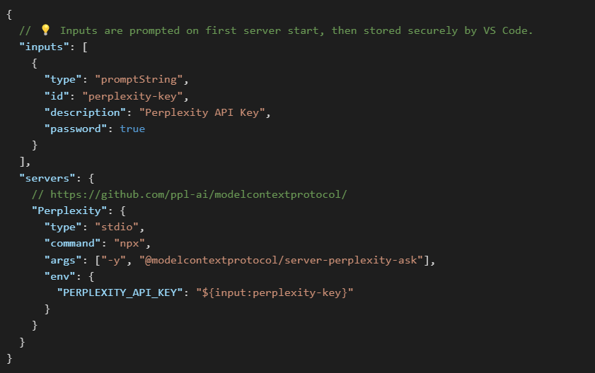
MCP?
MCP provides a standardized way for AI models to discover what tools are available, understand how to use them correctly, and maintain conversation context while switching between different tools. It brings determinism and structure to agent-tool interactions, enabling reliable integration without custom code for each new tool
Standard configuration
Notes:
Some of the common challenges that effect developer experience are:

Slide 10
MCP
Demo
Notes:
Let’s see GitHub Copilot in action!

Slide 11
Questions?
Is AI coming to take my job?
What can I do to increase my chance of getting a job?
If you were a rocketship what color would you be?
Notes:
Let’s see GitHub Copilot in action!

